Slide 1
AI chatbot using Chatgpt (NLP, LLM, DL - GAN’s)
TSP- AI ML Fundamentals (Capstone Project)
Presented By:
R. RAGHUNATHAN (2021502033)
Department of Automobile Engineering
Anna University, MIT Campus
Guided By: Ramar

Slide 2
OUTLINE
Problem Statement
Proposed System/Solution
Algorithm & Deployment
Code
Project Demo(photos / videos)
Conclusion
Future Scope
References

Slide 3
Problem Statement
Certainly, there's a problem in developing an AI chatbot that uses ChatGPT (Natural Language Processing), LLM (Large Language Models), and DL (Deep Learning) methodologies as GANs (Generative Adversarial Networks). Create and develop an AI chatbot capable of having meaningful natural conversations with users on any topic.
The Natural Language Processing (NLP) state-of-the-art techniques should be utilized in the process such as using ChatGPT or other similar Large Language Models (LLMs) to give sense to the user inputs and generate appropriate answers as well as keep up with the flow of conversation.
In addition, Deep Learning algorithms like Generative Adversarial Networks [GANs] should be incorporated for improved conversational experience by producing diverse and realistic responses.
The GANs component can serve purposes such as response generation, improving creativity, or handling imitations that come with pre-trained language models.

Slide 4
Proposed Solution
Open-source language modes like Jurassic-1, Jumbo, Gemini, or BLOOM can be customized for chatbots. There are also chatbot frameworks such as Rasa or Dialog flow that allow building chatbots and integrating various natural language processing models. While ChatGPT shows potential for chatbot development, exploring other options or waiting for wider API access may currently be more practical approaches.

Slide 5
Algorithm & Deployment
Define the Purpose and Scope: Determine the specific purpose of your chatbot and the scope of its abilities. For example, is it for customer service, providing information, or something else?
Choose a Platform: Decide where your chatbot will be deployed. This could be on a website, a messaging platform like Slack or Facebook Messenger, or a standalone app.
Select a Model: Choose the ChatGPT model that best suits your needs. For example, ChatGPT-3.5 for more complex conversations or ChatGPT-2 for simpler interactions.
Set Up the Environment: Set up your development environment with the necessary tools and libraries. You can use Python with the OpenAI API for this purpose.
Collect and Prepare Data: Gather and prepare a dataset of conversations relevant to your chatbot's purpose. This will be used to fine-tune the ChatGPT model if needed.
Fine-tune the Model (Optional): If you have a specific dataset, you can fine-tune the ChatGPT model using techniques like transfer learning to make it more relevant to your chatbot's domain.
Integrate with the API: Use the OpenAI API to integrate the ChatGPT model into your chatbot application. This will allow you to send input to the model and receive responses.
Implement Conversational Logic: Develop the logic for handling conversations, including understanding user input, generating responses, and maintaining context.
Test and Iterate: Test your chatbot extensively to ensure it functions as expected. Iterate on the design and logic based on feedback and usage data.
Deploy and Monitor: Deploy your chatbot to your chosen platform and monitor its performance. Continuously improve the chatbot based on user feedback and analytics.

Slide 6
Code
import re
import long_responses as long
def message_probability(user_message, recognised_words, single_response=False, required_words=[]):
message_certainty = 0
has_required_words = True
# Counts how many words are present in each predefined message
for word in user_message:
if word in recognised_words:
message_certainty += 1
# Calculates the percent of recognised words in a user message
percentage = float(message_certainty) / float(len(recognised_words))
# Checks that the required words are in the string
for word in required_words:
if word not in user_message:
has_required_words = False
break
# Must either have the required words, or be a single response
if has_required_words or single_response:
return int(percentage * 100)
else:
return 0
def check_all_messages(message):
highest_prob_list = {}
# Simplifies response creation / adds it to the dict
def response(bot_response, list_of_words, single_response=False, required_words=[]):
nonlocal highest_prob_list
highest_prob_list[bot_response] = message_probability(message, list_of_words, single_response, required_words)
def response(list_of_words, )
# Responses -------------------------------------------------------------------------------------------------------
response('Hello!', ['hello', 'hi', 'hey', 'sup', 'heyo'], single_response=True)
response('See you!', ['bye', 'goodbye'], single_response=True)
response('I\'m doing fine, and you?', ['how', 'are', 'you', 'doing'], required_words=['how'])
response('You\'re welcome!', ['thank', 'thanks'], single_response=True)
response('Thank you!', ['i', 'love', 'code', 'palace'], required_words=['code', 'palace'])
response('dina',['what','is','your','name'],required_words=['name'])
responses = {
"hello": ["Hello!", "Hi there!", "Hey!", "Hi!", "Greetings!"],
"how are you": ["I'm good, thanks!", "Feeling great!", "I'm doing well, how about you?", "I'm fine, thanks for asking!"],
"what's your name": ["I'm just a simple chatbot!", "You can call me ChatBot.", "I don't have a name, but you can call me whatever you like.", "I'm an AI chatbot designed to assist you!"],
"bye": ["Goodbye!", "Bye!", "See you later!", "Take care!", "Farewell!"],
"thanks": ["You're welcome!", "No problem!", "Anytime!", "Glad I could help!", "You're welcome! Is there anything else I can assist you with?"],
"how old are you": ["I don't have an age. I'm just a program!", "I'm ageless!", "I exist beyond the concept of time!"],
"what can you do": ["I can answer your questions, tell jokes, or just chat with you!", "I'm here to assist you with anything you need!", "I can provide information, entertain you, or just keep you company!"],
"tell me a joke": ["Why don't scientists trust atoms? Because they make up everything!", "Did you hear about the mathematician who's afraid of negative numbers? He'll stop at nothing to avoid them!"],
"default": ["I'm not sure I understand.", "Could you please rephrase that?", "Sorry, I didn't get that."]}
# Longer responses
response(long.R_ADVICE, ['give', 'advice'], required_words=['advice'])
response(long.R_EATING, ['what', 'you', 'eat'], required_words=['you', 'eat'])
best_match = max(highest_prob_list, key=highest_prob_list.get)
# print(highest_prob_list)
# print(f'Best match = {best_match} | Score: {highest_prob_list[best_match]}')
return long.unknown() if highest_prob_list[best_match] < 1 else best_match
# Used to get the response
def get_response(user_input):
split_message = re.split(r'\s+|[,;?!.-]\s*', user_input.lower())
response = check_all_messages(split_message)
return response
# Testing the response system
while True:
print('Bot: ' + get_response(input('You: ')))

Slide 7
Code
if word not in user_message:
has_required_words = False
break
# Must either have the required words, or be a single response
if has_required_words or single_response:
return int(percentage * 100)
else:
return 0
def check_all_messages(message):
highest_prob_list = {}
# Simplifies response creation / adds it to the dict
def response(bot_response, list_of_words, single_response=False, required_words=[]):
nonlocal highest_prob_list
highest_prob_list[bot_response] = message_probability(message, list_of_words, single_response, required_words)
def response(list_of_words, )
# Responses -------------------------------------------------------------------------------------------------------
response('Hello!', ['hello', 'hi', 'hey', 'sup', 'heyo'], single_response=True)
response('See you!', ['bye', 'goodbye'], single_response=True)
response('I\'m doing fine, and you?', ['how', 'are', 'you', 'doing'], required_words=['how'])
response('You\'re welcome!', ['thank', 'thanks'], single_response=True)
response('Thank you!', ['i', 'love', 'code', 'palace'], required_words=['code', 'palace'])
response('dina',['what','is','your','name'],required_words=['name'])
responses = {
"hello": ["Hello!", "Hi there!", "Hey!", "Hi!", "Greetings!"],
"how are you": ["I'm good, thanks!", "Feeling great!", "I'm doing well, how about you?", "I'm fine, thanks for asking!"],
"what's your name": ["I'm just a simple chatbot!", "You can call me ChatBot.", "I don't have a name, but you can call me whatever you like.", "I'm an AI chatbot designed to assist you!"],
"bye": ["Goodbye!", "Bye!", "See you later!", "Take care!", "Farewell!"],
"thanks": ["You're welcome!", "No problem!", "Anytime!", "Glad I could help!", "You're welcome! Is there anything else I can assist you with?"],
"how old are you": ["I don't have an age. I'm just a program!", "I'm ageless!", "I exist beyond the concept of time!"],
"what can you do": ["I can answer your questions, tell jokes, or just chat with you!", "I'm here to assist you with anything you need!", "I can provide information, entertain you, or just keep you company!"],
"tell me a joke": ["Why don't scientists trust atoms? Because they make up everything!", "Did you hear about the mathematician who's afraid of negative numbers? He'll stop at nothing to avoid them!"],
"default": ["I'm not sure I understand.", "Could you please rephrase that?", "Sorry, I didn't get that."]}
# Longer responses
response(long.R_ADVICE, ['give', 'advice'], required_words=['advice'])
response(long.R_EATING, ['what', 'you', 'eat'], required_words=['you', 'eat'])
best_match = max(highest_prob_list, key=highest_prob_list.get)
# print(highest_prob_list)
# print(f'Best match = {best_match} | Score: {highest_prob_list[best_match]}')
return long.unknown() if highest_prob_list[best_match] < 1 else best_match
# Used to get the response
def get_response(user_input):
split_message = re.split(r'\s+|[,;?!.-]\s*', user_input.lower())
response = check_all_messages(split_message)
return response
# Testing the response system
while True:
print('Bot: ' + get_response(input('You: ')))

Slide 8
Code
highest_prob_list[bot_response] = message_probability(message, list_of_words, single_response, required_words)
def response(list_of_words, )
# Responses -------------------------------------------------------------------------------------------------------
response('Hello!', ['hello', 'hi', 'hey', 'sup', 'heyo'], single_response=True)
response('See you!', ['bye', 'goodbye'], single_response=True)
response('I\'m doing fine, and you?', ['how', 'are', 'you', 'doing'], required_words=['how'])
response('You\'re welcome!', ['thank', 'thanks'], single_response=True)
response('Thank you!', ['i', 'love', 'code', 'palace'], required_words=['code', 'palace'])
response('dina',['what','is','your','name'],required_words=['name'])
# Longer responses
response(long.R_ADVICE, ['give', 'advice'], required_words=['advice'])
response(long.R_EATING, ['what', 'you', 'eat'], required_words=['you', 'eat'])
best_match = max(highest_prob_list, key=highest_prob_list.get)
# print(highest_prob_list)
# print(f'Best match = {best_match} | Score: {highest_prob_list[best_match]}')
return long.unknown() if highest_prob_list[best_match] < 1 else best_match
# Used to get the response
def get_response(user_input):
split_message = re.split(r'\s+|[,;?!.-]\s*', user_input.lower())
response = check_all_messages(split_message)
return response
# Testing the response system
while True:
print('Bot: ' + get_response(input('You: ')))

Slide 9
Code
best_match = max(highest_prob_list, key=highest_prob_list.get)
# print(highest_prob_list)
# print(f'Best match = {best_match} | Score: {highest_prob_list[best_match]}')
return long.unknown() if highest_prob_list[best_match] < 1 else best_match
# Used to get the response
def get_response(user_input):
split_message = re.split(r'\s+|[,;?!.-]\s*', user_input.lower())
response = check_all_messages(split_message)
return response
# Testing the response system
while True:
print('Bot: ' + get_response(input('You: ')))

Slide 10
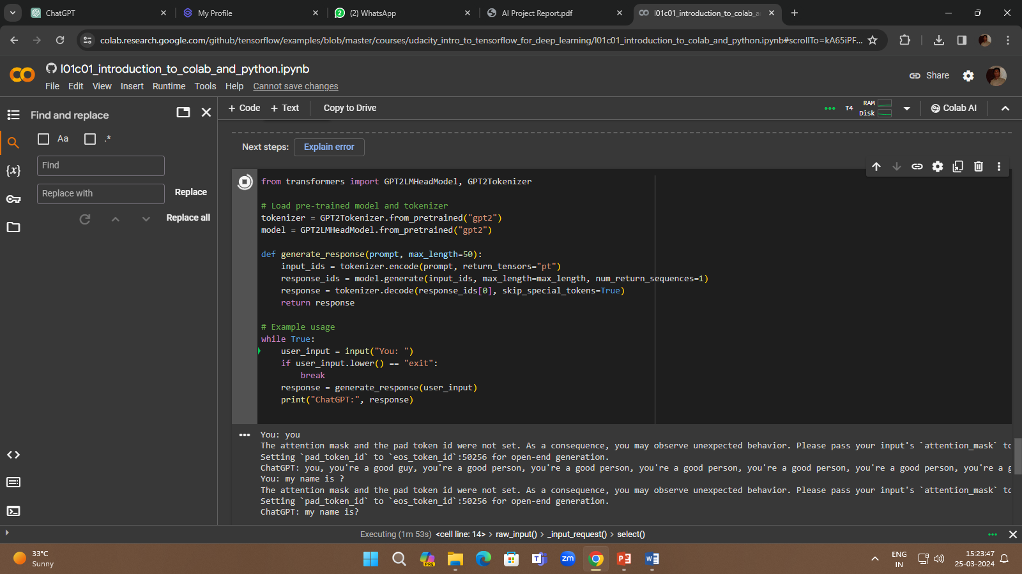
Project Demo

Slide 11
Conclusion
Combining ChatGPT with GANs offers a powerful framework for building advanced AI chatbots that excel in understanding and generating natural language responses. With continued research and development in this field, we can expect further improvements in chatbot technology, leading to more sophisticated and human-like conversational experiences.

Slide 12
Future Scope
AI chatbots powered by LLM technology like ChatGPT have a wide range of applications, including
Customer service: Chatbots can answer customer queries, provide product information, and resolve basic issues, freeing up human agents for more complex tasks.
Education: Chatbots can be used as intelligent tutors, providing personalized learning experiences and answering student questions.
Healthcare: Chatbots can be used to triage patients, answer basic medical questions, and provide mental health support.
Entertainment: Chatbots can be used to create interactive games, stories, and social experiences.
Information assistants: Chatbots can be integrated into various devices and platforms to provide users with information and complete tasks.

Slide 13
References
https://chat.openai.com/c/43484333-d13e-4801-b8c3-01cd9e481a13

Slide 14
THANK YOU

